Slide 1



SOTI Solution Presentation Deck
Exploring solutions to SOTI’s sales generation and conversion problems

Slide 2


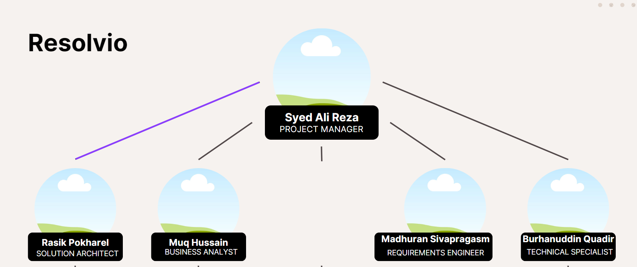



Our Team
Alfredo
Torres
Estelle Darcy
Takehiro Kanegi
CEO
MARKETING
FINANCE

Slide 3

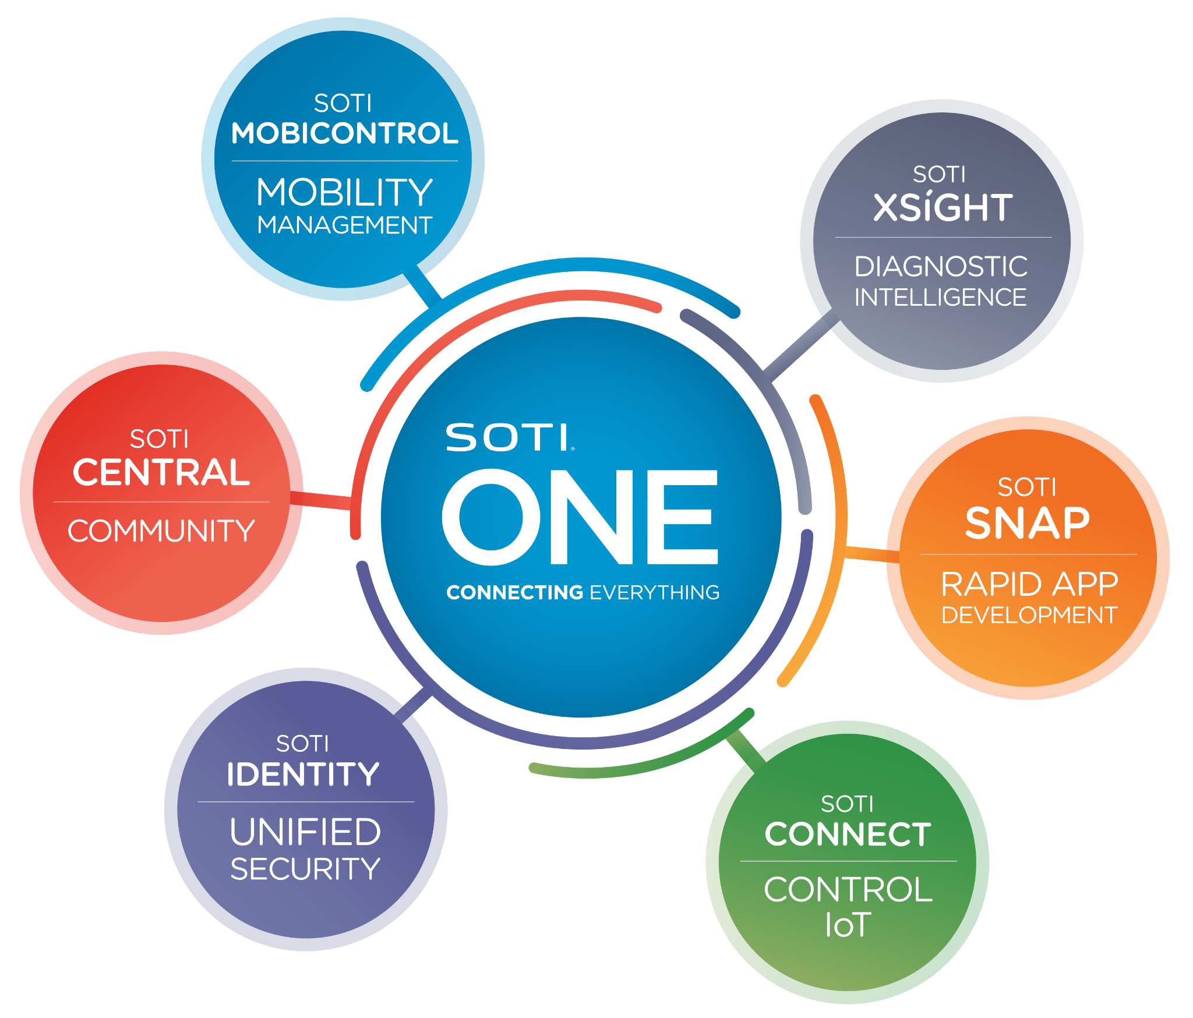

Introduction
Who We Are:
Resolvio, a group of aspiring professionals with a shared passion for solving real-world challenges through innovation, teamwork, and strategic thinking.
Our Project Partner:
For this project, we are excited to collaborate with SOTI, a leader in the mobility management sector. Together, we aim to address key challenges and propose impactful solutions.

Slide 4

Industry Partner Overview

Slide 5

Company Background
Established leader in Enterprise Mobility Management
Headquarters based in Mississauga, Ontario
Mission: Provide advanced solutions for EMM
Notes:
Founded to address the growing need for reliable and secure enterprise mobility solutions
Global presence and offices in multiple countries
To empower businesses by providing advanced software solutions that simplify and secure the management of mobile devices, applications and content

Slide 6
Corporate Structure and Team:
Privately held company led by a strong executive team
Robust workforce that drives product innovation and customer satisfaction.
Promotes a dynamic work environment
Business Sector and Industry:
Operates within the enterprise mobility management (EMM) industry
Software platforms that manage, troubleshoot, and secure devices
Notes:
Corporate Structure and Team:
Privately held company led by a strong executive team with expertise in software development, technology solutions, and business strategy
A robust workforce consisting of engineers, developers, sales professionals, and customer support teams that drive product innovation and customer satisfaction.
Promotes a dynamic work environment focused on continuous improvement and responding to evolving market needs.
Business Sector and Industry:
SOTI operates within the enterprise mobility management (EMM) industry, providing cutting-edge solutions that help organizations manage their mobile device ecosystems.
Focuses on developing software platforms that manage, troubleshoot, and secure devices across a business's operations, including tablets, smartphones, and other connected devices.

Slide 7
Customer Base:
Logistics, healthcare, retail, field services, and education
Tailored software solutions
Why we chose SOTI:
Aligns with our team's expertise in engineering and management.
Address meaningful challenges showcasing our ability to develop scalable solutions
Notes:
Customer Base:
Services a wide range of industries, including logistics, healthcare, retail, field services, and education, with clients ranging from mid-sized businesses to large multinational corporations.
Ensures client success through tailored software solutions, responsive customer service, and continuous product updates.
Why we chose SOTI?
SOTI’s commitment to technology-driven solutions and enterprise growth aligns with our team's expertise in engineering and management.
The project allows us to address meaningful challenges within the company showcasing our ability to develop scalable solutions that enhance business performance.

Slide 8
SWOT Analysis
Strengths 17,000 enterprise customers worldwide Over 2000 employees and established internal infrastructure Over two decades of experience in the mobility industry | Weakness Reliance on human sales staff for all sales SOTI uses limited innovative technology in Sales Mobility services are complex products that require experience and documentation

Slide 9
SWOT Analysis
Opportunities Work from home trends means more demand for mobility products Recent high profile cybersecurity threats increase demand Advancements in AI present an opportunity to improve internal tooling | Threats Mobility is a competitive industry containing industry giants like IBM Newer competitors will leverage more advanced technology ​ Difficult for businesses to swap to SOTI mobility due to friction

Slide 10
Business Problem

Slide 11

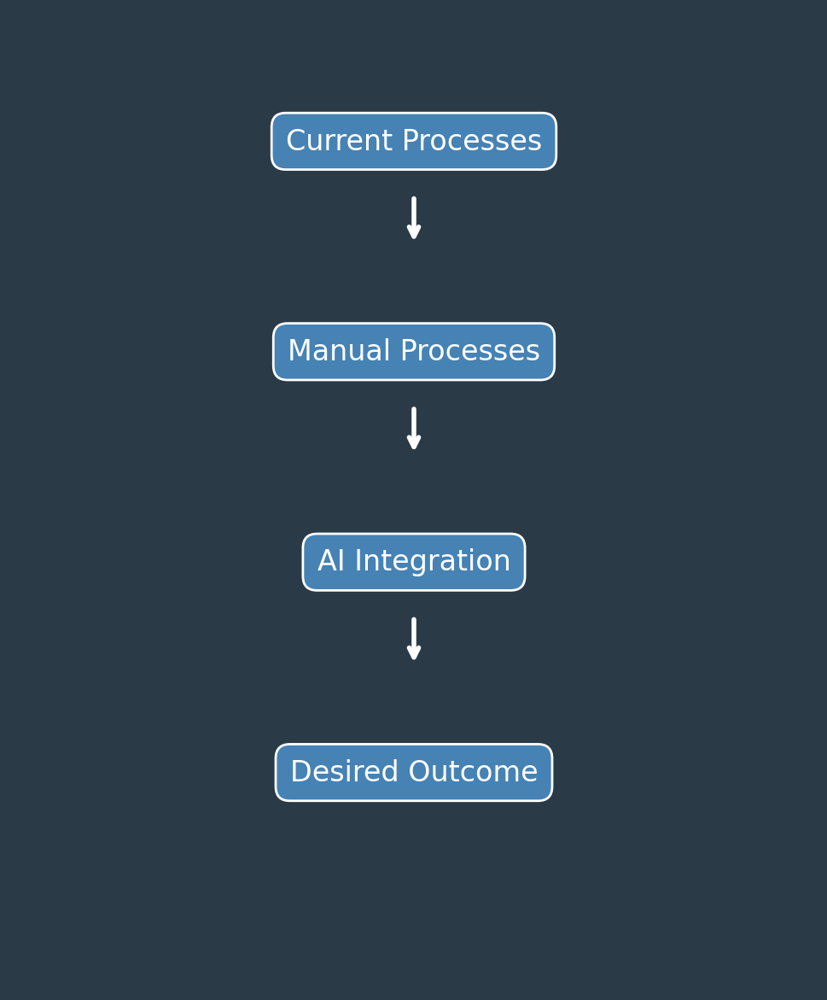

Project Charter Overview
Objective/Goal
Enhance SOTI’s inbound call center efficiency to increase lead generation by 30% and conversion rates by 15%.
Key Challenges
Limited capacity in lead generation.
High dependency on manual processes.
Inefficient conversion pathways.

Slide 12
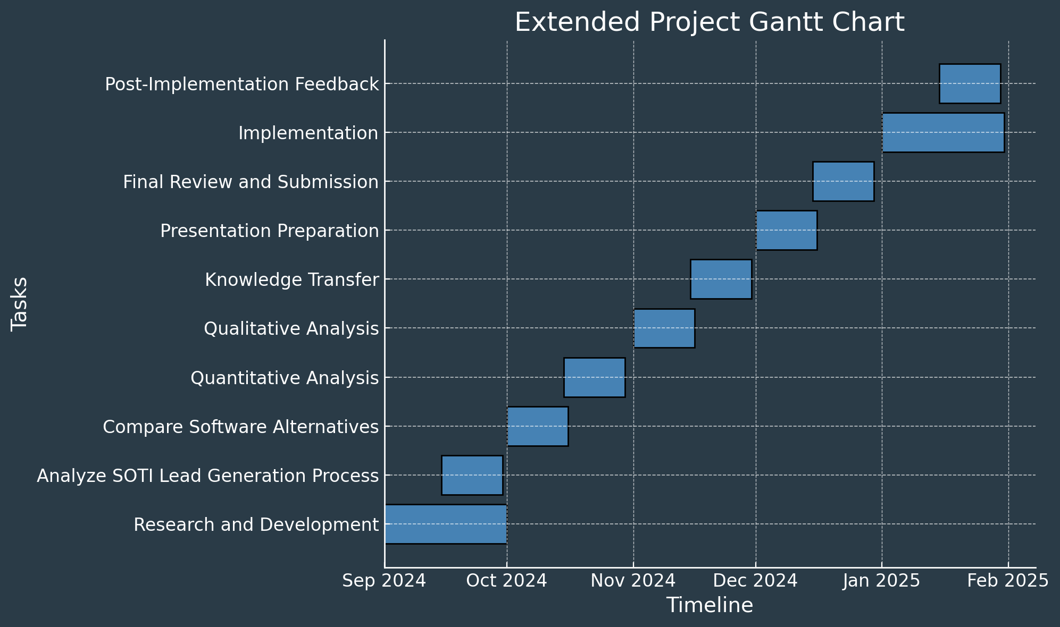
Scope of Work
Tasks and Deliverables:
Analyze current call center operations.
Develop a robust risk management strategy.
Implement a solution to meet business goals.
Approach to Delivery:
Weekly updates and feedback loops with SOTI.
Decision matrix for evaluating solution efficacy.

Slide 13
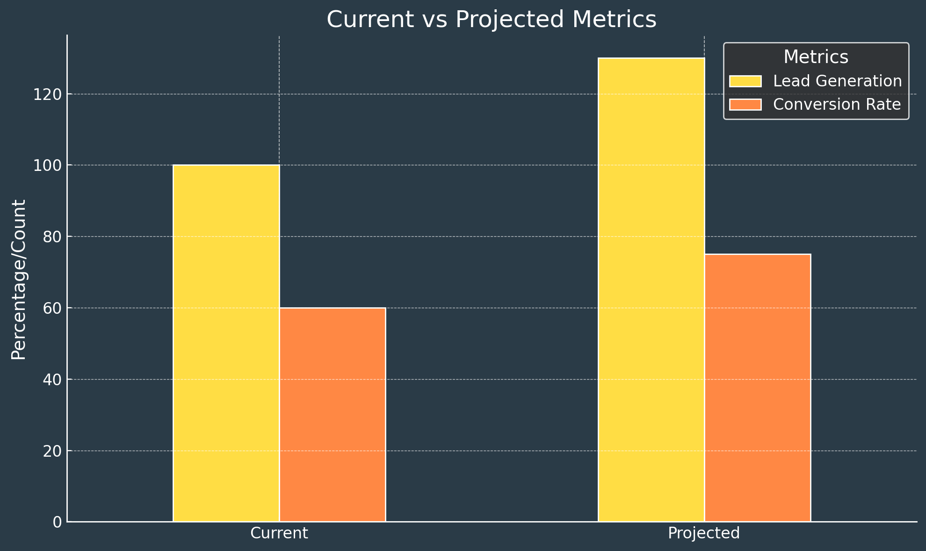
Project Objectives
Quantitative:
Generate 30% more leads.
Improve conversion rates by 15%.
Qualitative:
Strengthen customer interactions.
Enhance team efficiency through automation.

Slide 14
Constraints & Assumptions
Constraints:
Budget: $10,000 allocated to labor and software tools.
Implementation timeframe: 1-month
Access: Limited to non-sensitive company data.
Assumptions:
Weekly access to key stakeholders.
Integration compatibility with existing tools.

Slide 15

Autonomous Sales Reps
AI powered Voice Assistants
Trained on sales agents voice and tone
Scalable yet personalized
Balances automation with human touch.
Automated Outreach
Focuses human agents on high-value tasks.
Notes:
AI-Powered Voice Assistants "AI-powered voice assistants are designed to emulate the voice and tone of real sales agents. By analyzing past interactions, these systems can deliver messages that feel natural and engaging, ensuring consistency across every customer touchpoint."
Scalable Yet Personalized "One of the key advantages of this technology is the balance it strikes between scalability and personalization. While it automates repetitive tasks, it retains a human-like touch, ensuring customers feel valued and understood, even at scale."
Automated Outreach "With high-volume outreach tasks handled by AI, human sales agents can focus on more complex, high-value opportunities. This not only improves efficiency but also enhances overall sales performance by prioritizing human effort where it matters most."
4o

Slide 16
How Does it Work?
Automated Outreach
Scales lead generation with low-priority calls.
AI Voice Model Training:
Human-Agent Focus
Scalable and Adaptive
Nurtures leads and closes sales
AI Voice Model Training: Mimics agents’ style using recorded calls.
Feedback loops optimize performance adapting to different campaign needs
Notes:
AI Voice Training & Outreach "Our AI begins by training on recorded sales calls to replicate the voice and style of human agents. Once ready, it takes over routine outreach, managing low-priority calls and scaling lead generation efficiently."
Human-Agent Focus "This allows human agents to focus their efforts on what they do best—nurturing qualified leads and closing high-value sales. By automating repetitive tasks, the team can allocate their time to impactful interactions."
Scalable & Adaptive "The AI system is not only scalable but highly adaptive. Continuous feedback loops ensure its performance improves over time, and it’s flexible enough to handle various campaign needs, from new lead generation to re-engagement and upselling.

Slide 17
Why this solution?
Lead Generation
Lead Conversion
Multiple outbound calls simultaneously
Expands reach
Agents focus on high value leads
Improves relationships
Consistency
Maintain SOTI’s brand tone
Customer experience

Slide 18

Virtual Sales Platform
What is it?
CRM platform for clients to purchase and use SOTI products without relying on sales staff
A second solution that optimizes the existing SOTI sales funnel
Comparison to existing CRM’s
Integrates directly with SOTI products and allows users to use the product through the platform
Benefits
Reduces friction in the sales process by making it easy for clients to purchase SOTI products

Slide 19


How Does it Work?
The service will enable users to purchase and use products all through one platform, the below steps display the general flow of the platform
Display product information and pricing
Generates a contract for product purchase
Support onboarding and direct product integration
Provides portal for technical assistance and IT support

Slide 20
Why is This a Solution?
Lead Generation
Lead Conversion
Provides an easy link to be sent in sales campaigns
Centralized system for generating leads
Allows sales staff to focus outreach on more difficult targets
Facilitates fast conversions without requiring human staff
Reduces friction for potential clients
Incentivizes purchases due to integrated onboarding and product support

Slide 21
Evaluation and Analysis

Slide 22
Project Risk
It is essential to recognize and address potential risks that could impact project success.
Identifying, analyzing, and planning for both AI integration and the virtual sales platform
Notes:
While the proposed solutions offer significant opportunities for SOTI, it is essential to recognize and address potential risks that could impact project success.
The risk assessment process included identifying, analyzing, and planning for both AI integration and the virtual sales platform to mitigate any adverse effects on project timelines, cost, and overall outcomes.

Slide 23
Risk Register
Risk ID | Description | Impact (High/Medium/Low) | Likelihood (High/Medium/Low) | Mitigation Measures
R1 | Complexity of AI Integration: | High | Medium | Conduct a pilot phase before full-scale deployment.
R2 | Data Security and Privacy Concerns: | High | Medium | Adhere to SOTI’s data privacy policies
R3 | Initial Cost and Resource Allocation for AI | High | Medium | Create a phased implementation plan
R4 | User Adoption and Resistance | Medium | Medium | Develop comprehensive training programs and engage in change management practices
R5 | Technical Limitations of the Virtual Sales Platform | Medium | Low | Conduct usability testing and gather feedback from pilot users
Notes:
R1
Complexity of AI Integration: Potential challenges with implementing AI technology that aligns seamlessly with existing systems.
Conduct a pilot phase to test AI compatibility before full-scale deployment. Allocate additional resources for technical support and training.
R2
Data Security and Privacy Concerns: Risks associated with handling client data securely during AI-led processes.
Adhere to SOTI’s data privacy policies and implement advanced security protocols. Regularly audit and update security measures to ensure compliance.
R3
Initial Cost and Resource Allocation for AI: High up-front costs and training requirements for deploying AI solutions.
Create a phased implementation plan that starts with critical areas to spread costs over time. Secure buy-in for budget allocation with projected ROI to justify investment.
R4
User Adoption and Resistance: Staff resistance to adopting AI tools and new workflows.
Develop comprehensive training programs and engage in change management practices to promote user confidence and adaptability. Involve agents early in the process for feedback and gradual integration.
R5
Technical Limitations of the Virtual Sales Platform: Potential challenges in creating an intuitive platform that meets client expectations for ease of use.
Conduct usability testing and gather feedback from pilot users to refine platform features. Work closely with UX designers to ensure user-friendly design.

Slide 24
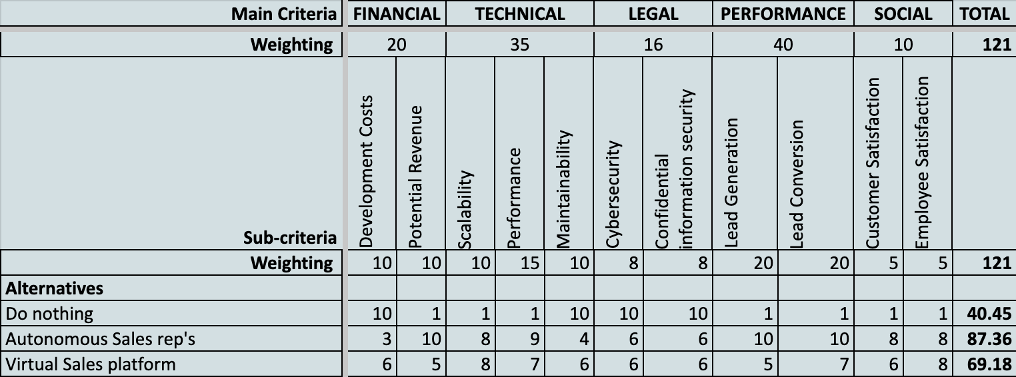
Weighted Evaluation Matrix
A weighted evaluation matrix which compares success across various domains

Slide 25


Recommended Plan: Autonomous Sales Rep’s
1
2
3
Reason 1
Reason 2
Reason 3
Provides better results with lead generation and lead conversion
Better user experience and performance
Worth the increased development costs and implementation difficulty

Slide 26
Implementation Plan

Slide 27



1-Month Implementation Roadmap
1
3
Day 1 - 5
Product design and choosing technology stack
Day 10 - 20
Main product implementation
2
4
Day 5 - 10
Proof of concept implementation
Day 20 - 30
Testing, bug fixing and refinements

Slide 28
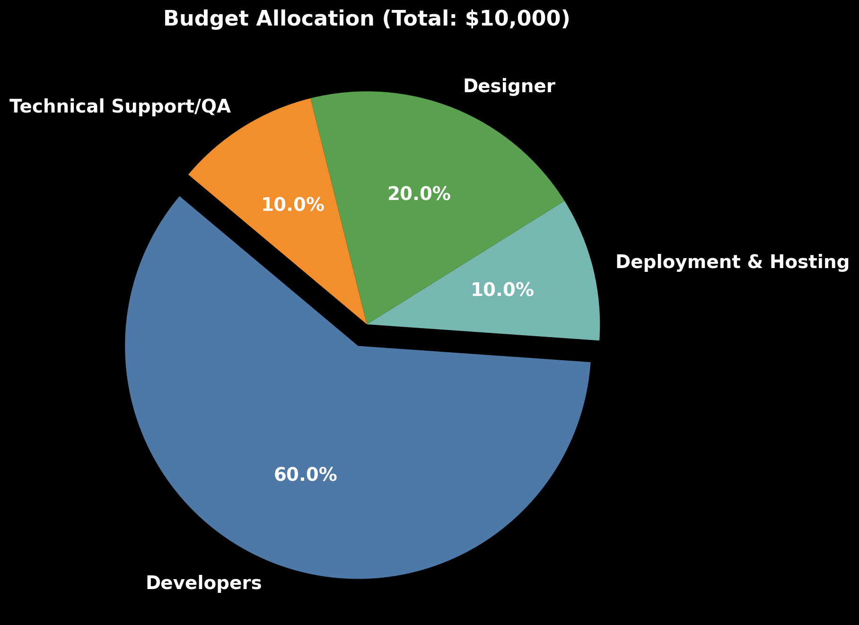
Budget
Our budget is allocated across various staff members and deployment costs

Slide 29
In Conclusion…
Recommended Solution: Autonomous Sales Representatives
Implementation plan timeline is 1 month with a $10,000 budget
This will aim to generate 30% more leads and improve conversion rates by 15%

Slide 30
Thank You!
Feel free to ask any questions

